Slide 1
Syrian Refugee Crisis

Slide 2
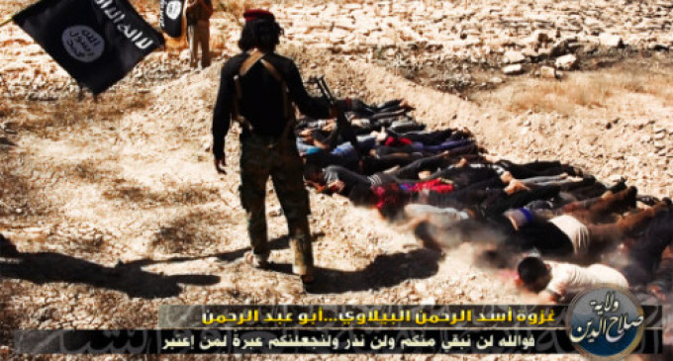
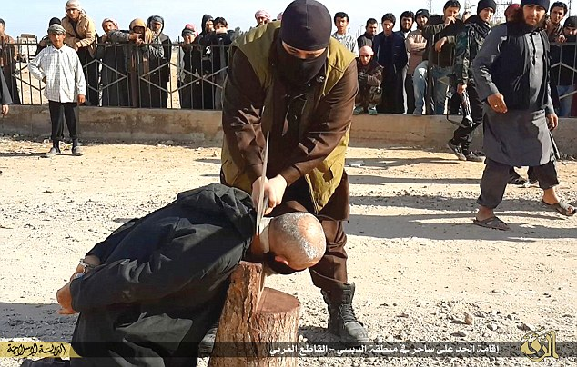
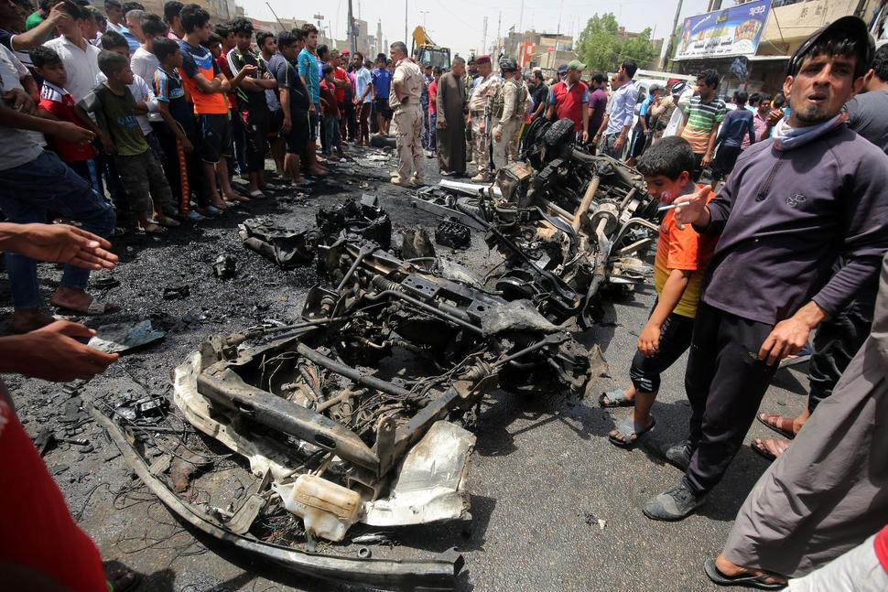
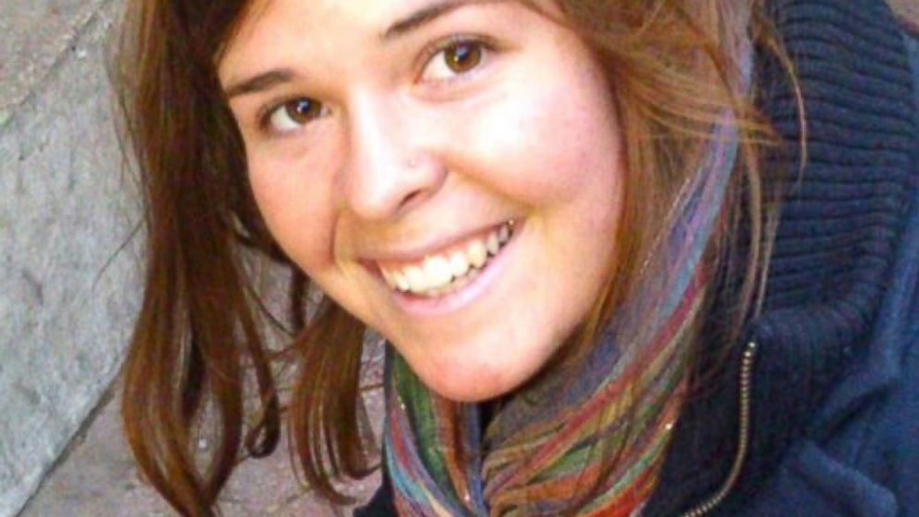
Can’t Stay

Slide 3
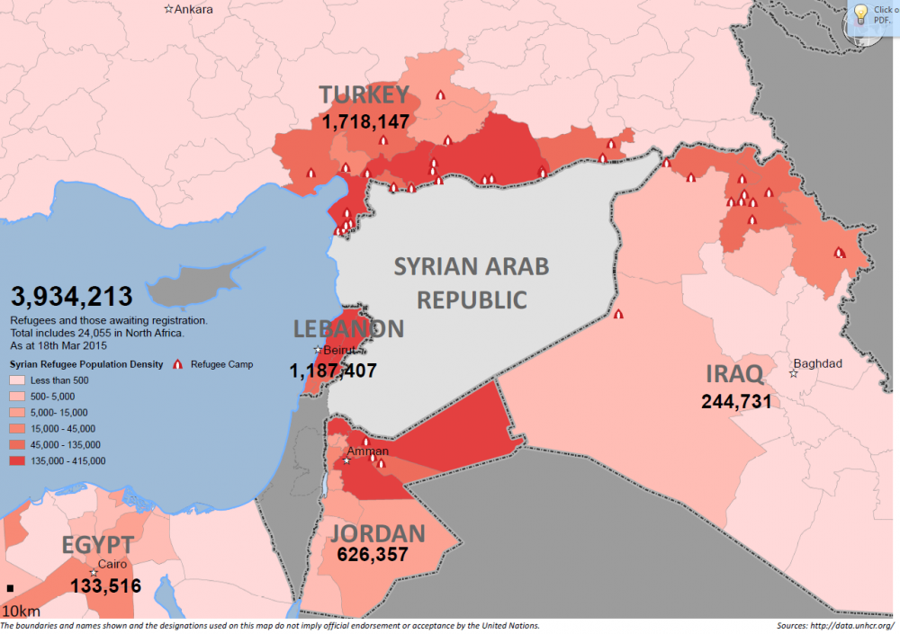
People are fleeing Syria
5.1 million Syrians have fled the country as refugees
6.3 million Syrians are displaced within the country. Half of those affected are children.

Slide 4
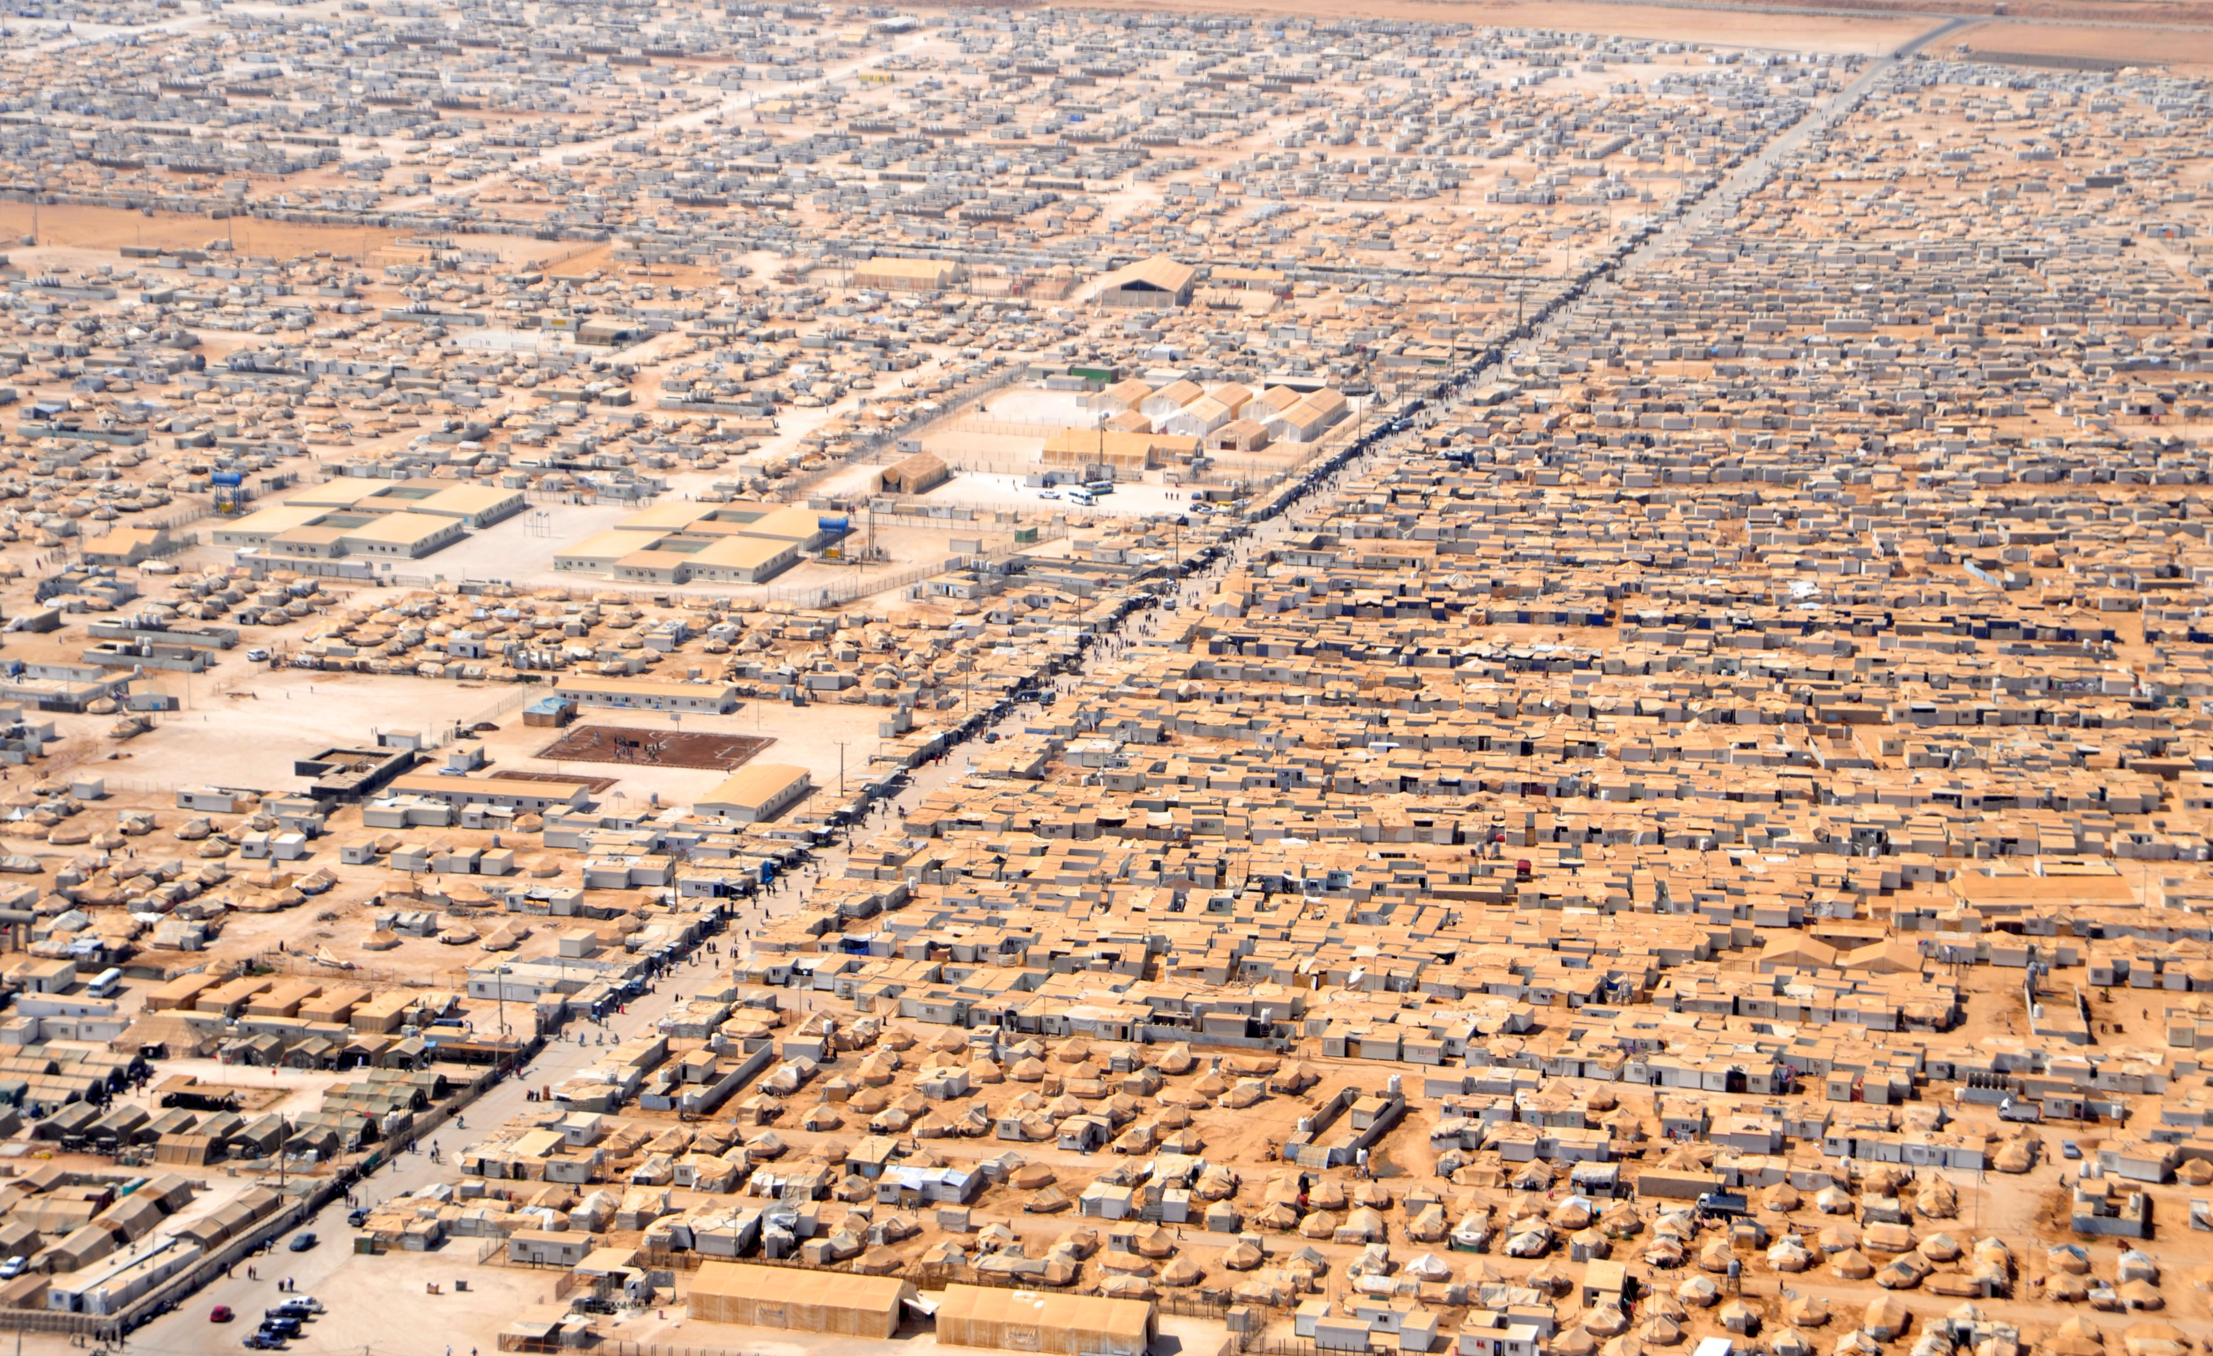
Camps are rough

Slide 5
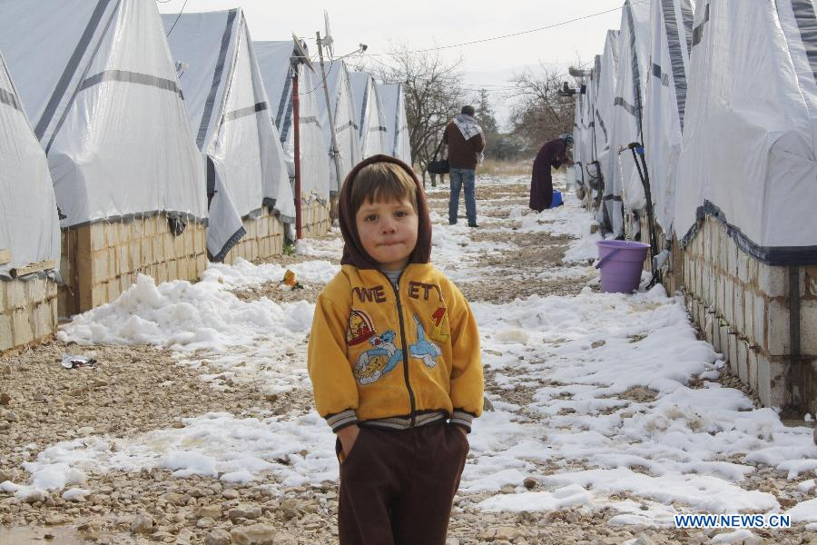

Slide 6
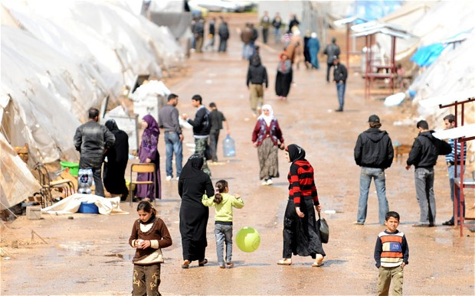

Slide 7
Camps cost money
Syrian refugees will cost ten times more to care for in Europe than in neighboring countries
A budget of $3,000 per refugee in Jordan would provide food, water, education and opportunity. In Germany this will cost $30,000
Sunday 13 March 20 – Independent.co.uk

Slide 8
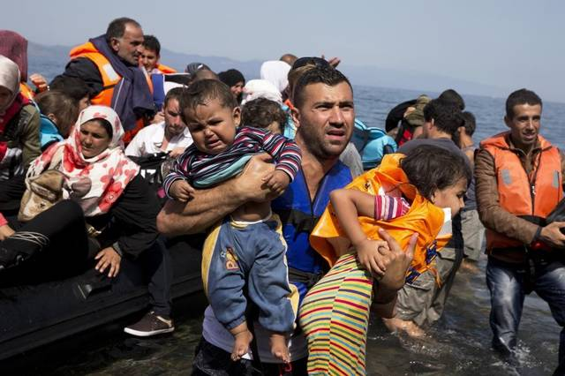

Slide 9
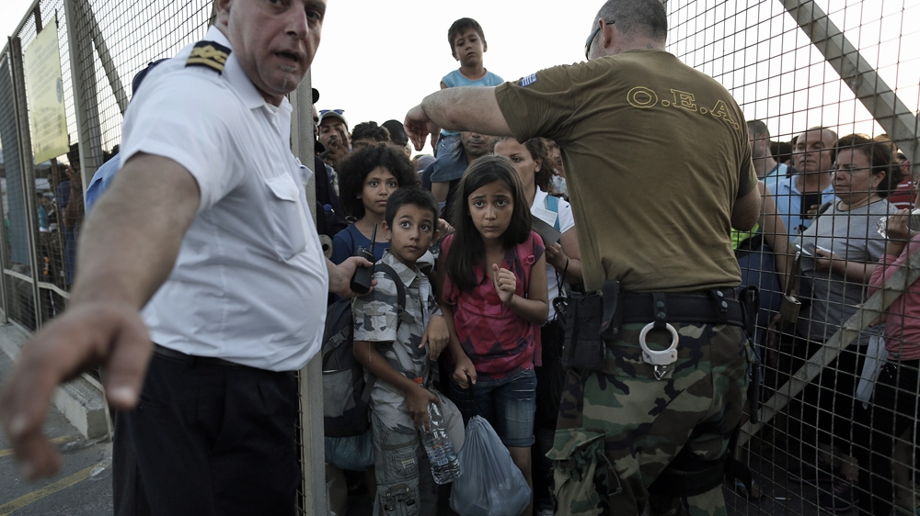

Slide 10
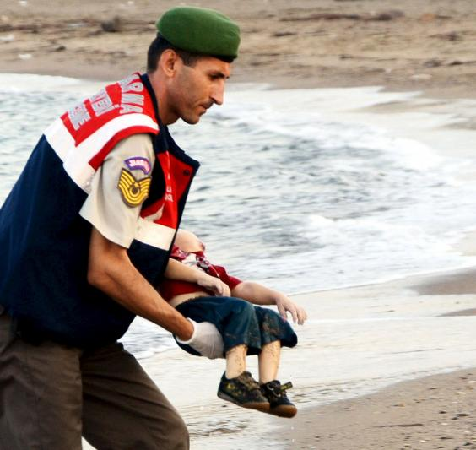

Slide 11
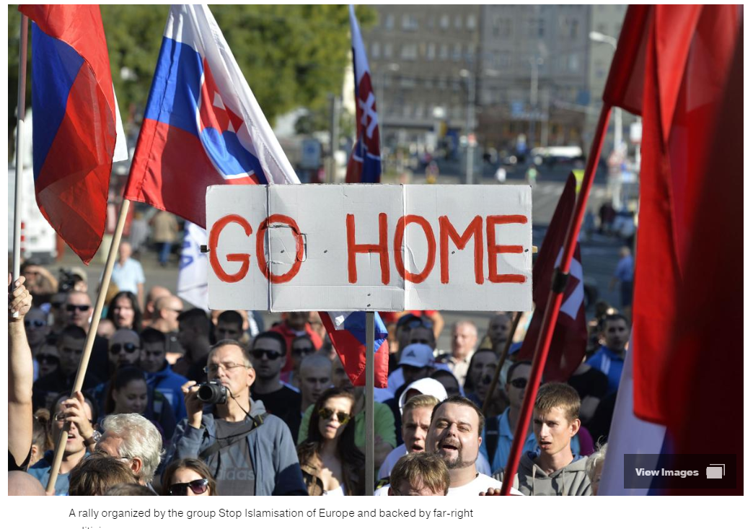

Slide 13
Counter Terrorism
SUMMARY Counter-terrorism (CT) spending by Western countries has increased over the past 15 years. Since 2001, United States (US) federal expenditure on homeland security has grown on average by $360 billion annually. While it is not possible to calculate total EU and Member State spending on CT with any precision, EU spending is estimated to have increased from €5.7 million in 2002 to €93.5 million in 2009

Slide 14
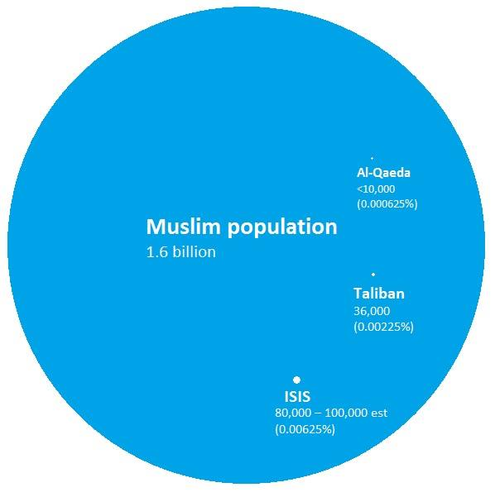

Slide 15
Country Groups
PM
John S
Colleen
Matheus
Lile
Mitchell
Justine B
Defense
Jewel B
Jack N
Tyler L
Brendan R
Liv P
State
Linda C
James C
Claire W
Robert M
Hayden P
CFO
Brianna S
Melissa H
Kerin M
Lauren D
Ally M

Slide 16
You are a European country
Your GDP is 100 billion
100,0000 Syrian refugees want to enter your country.
It will cost you $3 million to help them settle.
You or your people may want to increase CT spending.
What are you going to do?
Give your solution
Give reasons it will work.
Give reasons it might not work.

