Slide 1
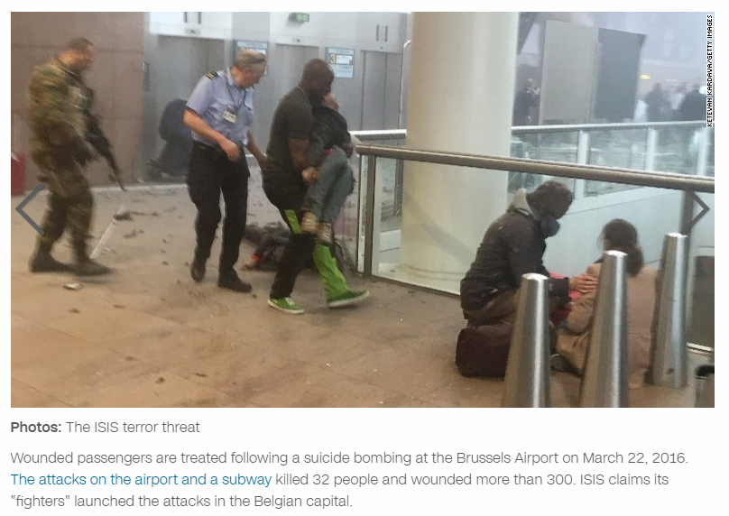

Slide 2
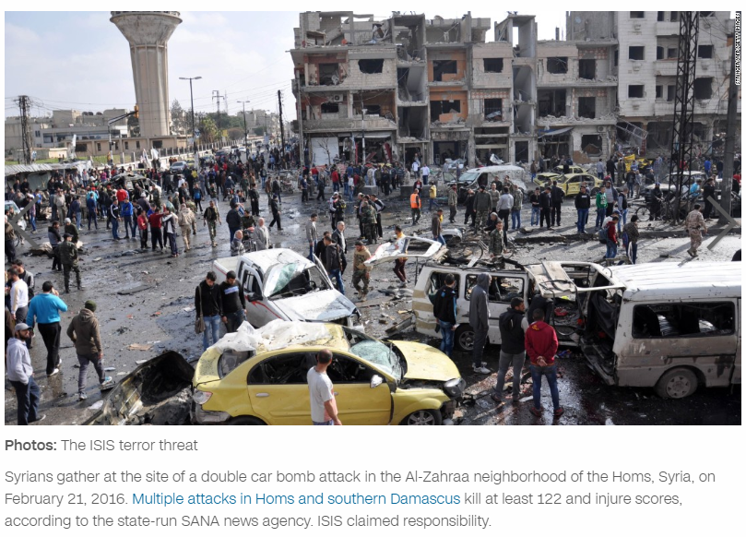

Slide 3
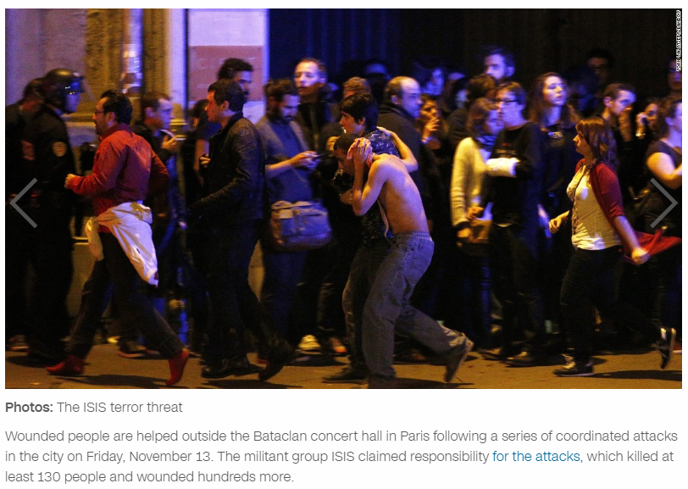

Slide 4
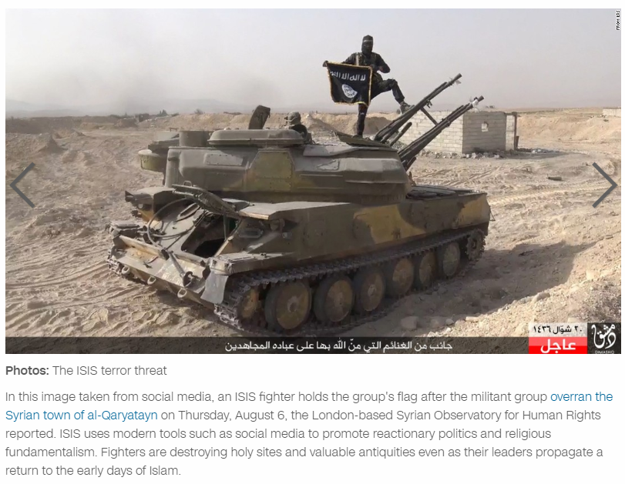

Slide 5
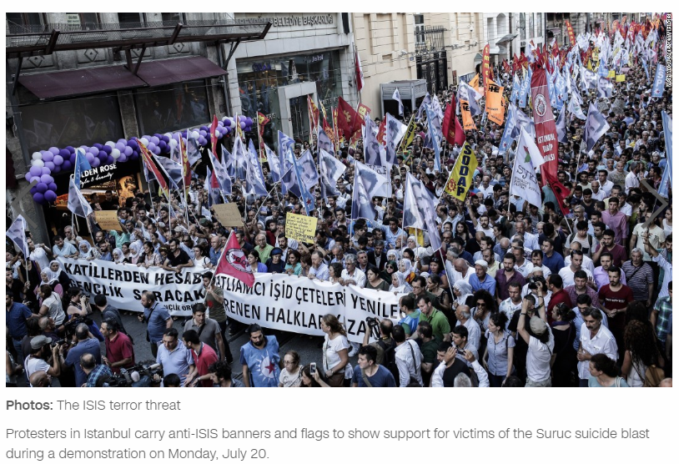

Slide 6
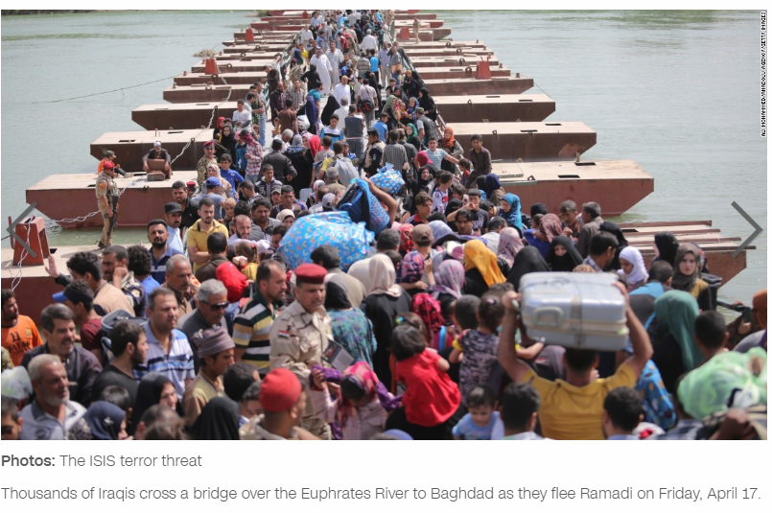

Slide 7
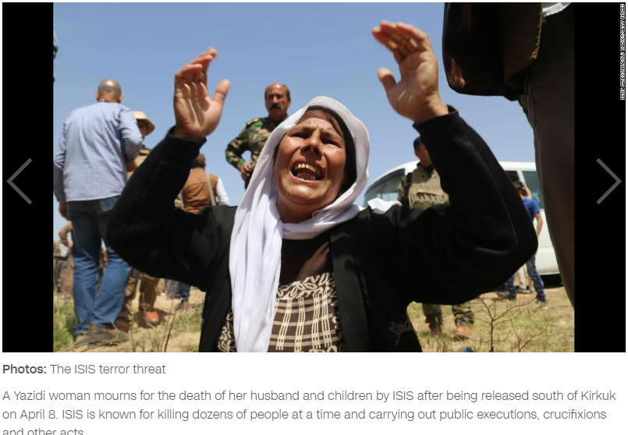

Slide 8
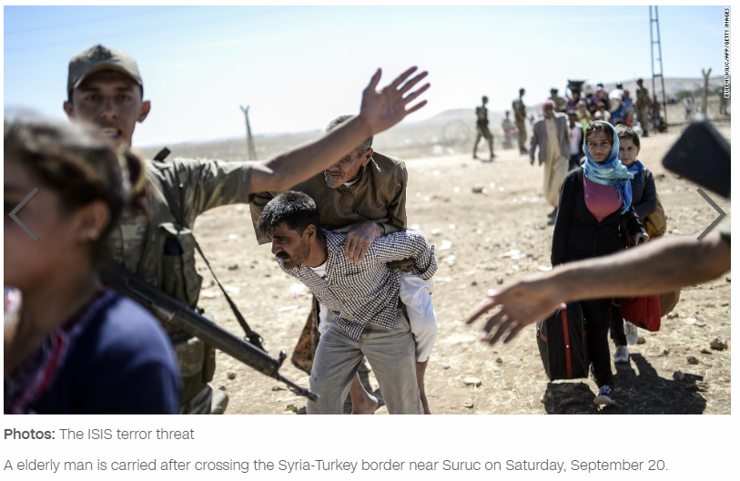

Slide 9
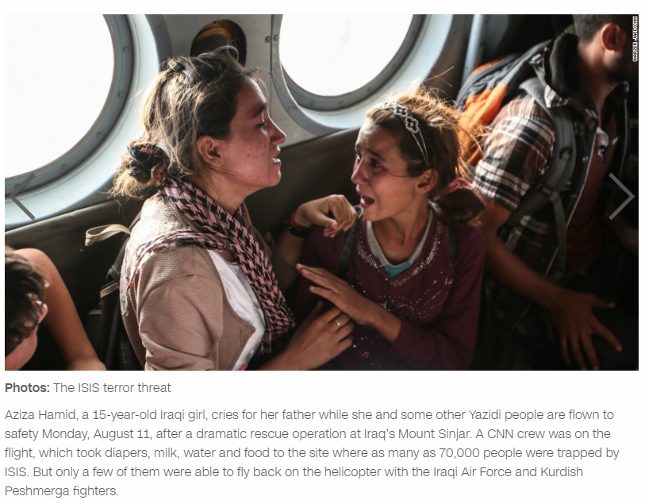

Slide 10
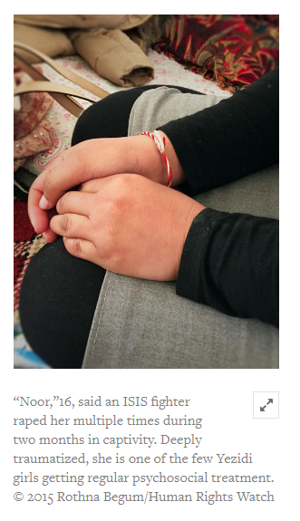
The longer they are held by ISIS, the more horrific life becomes for Yezidi women, bought and sold, brutally raped, their children torn from them. Meanwhile, ISIS’s restrictions on Sunni women cut them off from normal life and services almost entirely.
Skye Wheeler, women’s rights emergencies researcher

Slide 11
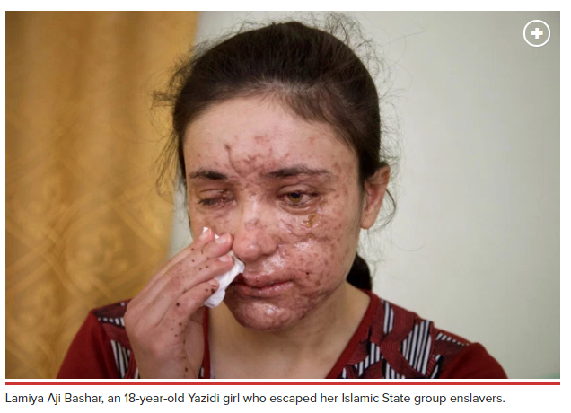
KHANKE, Iraq — The advertisement on the Telegram app is as chilling as it is incongruous: A girl for sale is “Virgin. Beautiful. 12 years old…. Her price has reached $12,500 and she will be sold soon.” The posting in Arabic appeared on an encrypted conversation along with ads for kittens, weapons and tactical gear. It was shared with the Associated Press by an activist with the minority Yazidi community, whose women and children are being held as sex slaves by the extremists.

