Slide 1
10-1 How does the state of Israel come to be? 10-2 How is Israel perceived in the Muslim world?

Slide 3
Five Major Religions
Christianity: 1.9 billion people
Islam: 1.1 billion
Hinduism: 800 million
Buddhism: 325 million
Judaism: 13 million

Slide 4
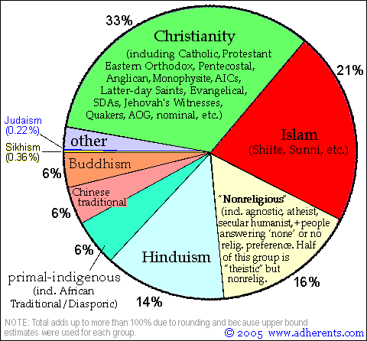

Slide 5
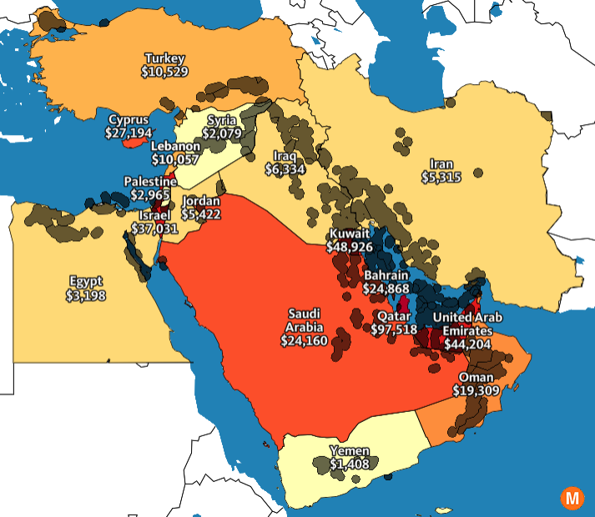

Slide 6
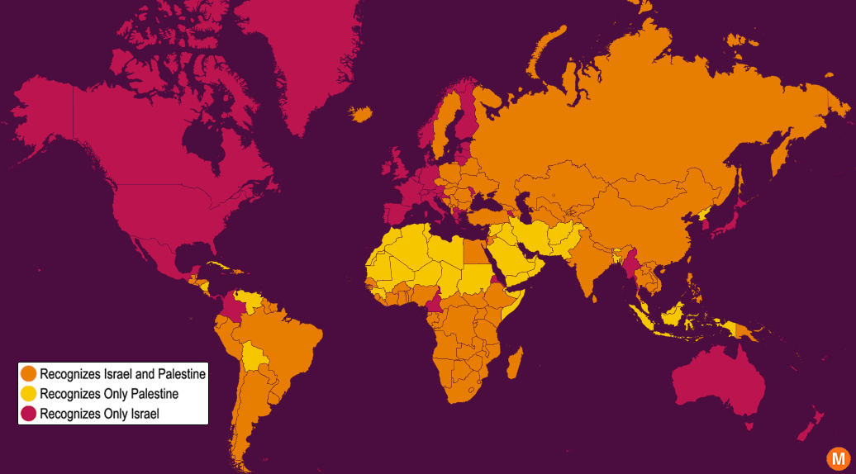

Slide 7
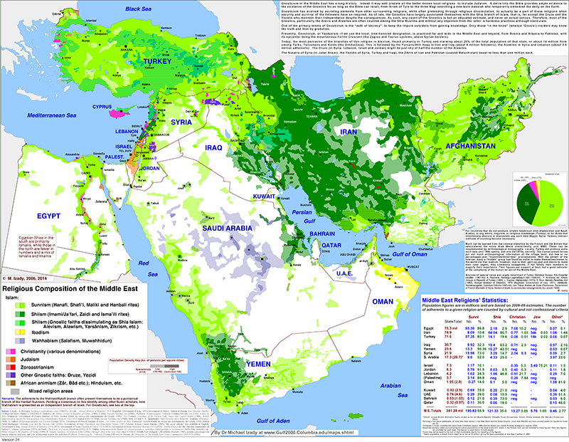

Slide 8
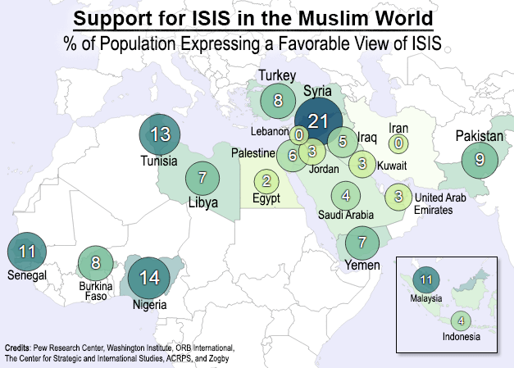

Slide 9
The Sykes-Picot Agreement 1916
Much of the Middle East’s current geopolitical order can be traced back to a crude map drawn by two men as part of a secret agreement in 1916.
Sir Mark Sykes (English) and François Georges-Picot (French) carved up the former Ottoman Empire into zones of influence for their respective countries.
These zones later formed the basis for many of the national borders, and ethnic / sectarian tensions, that persist in the Middle East today.

Slide 10
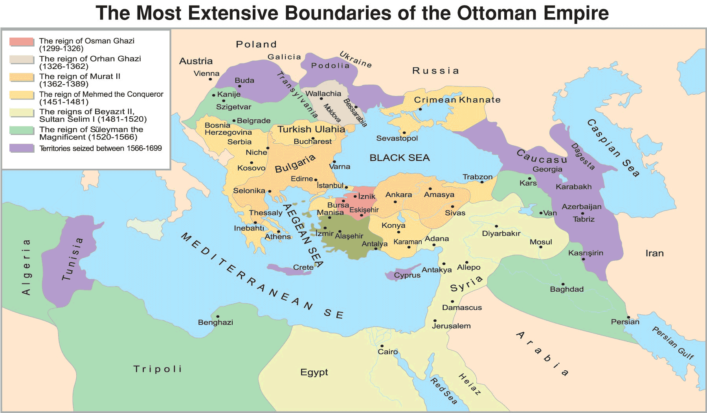

Slide 11
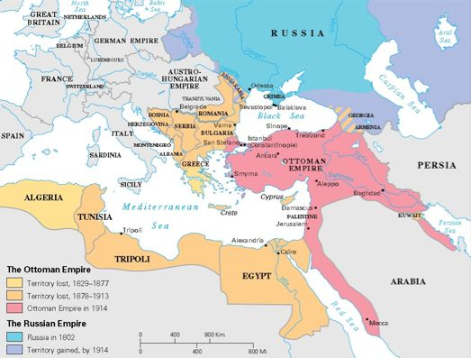

Slide 12
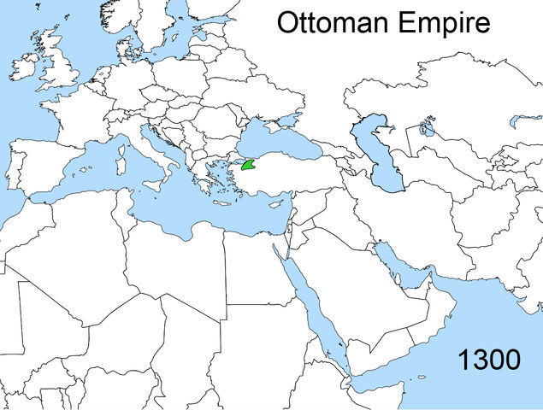

Slide 13
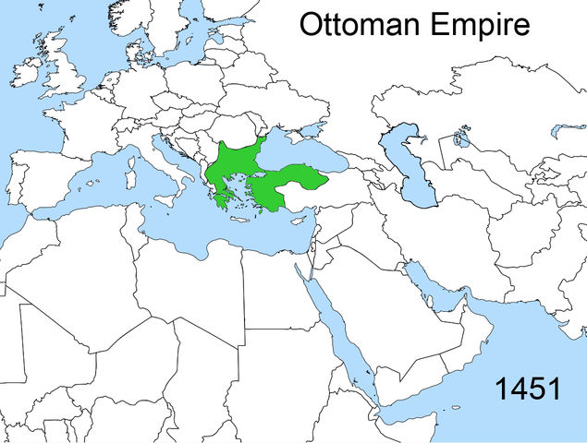

Slide 14
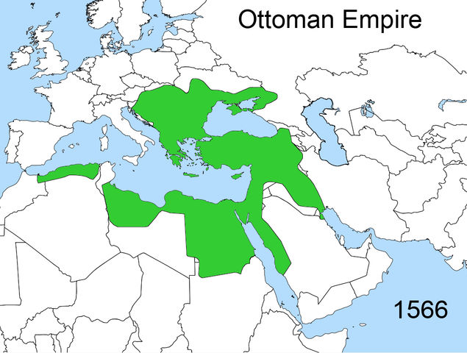

Slide 15
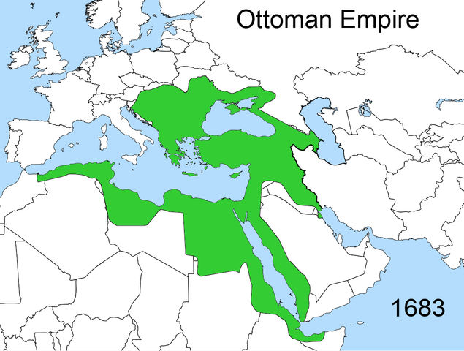

Slide 16
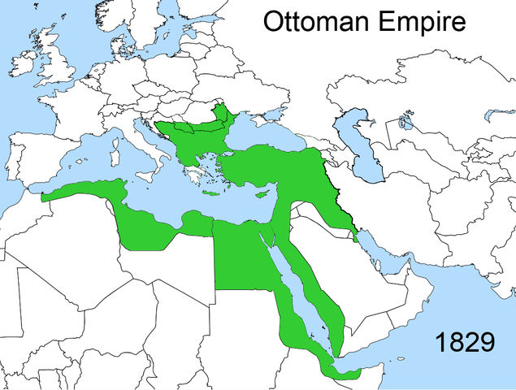

Slide 17
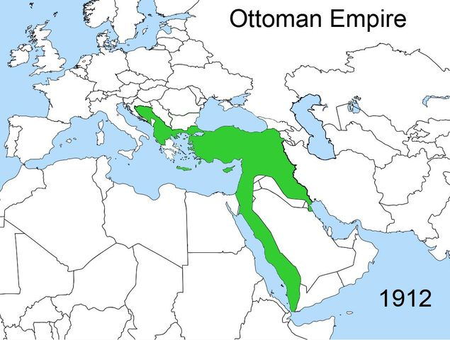

Slide 18
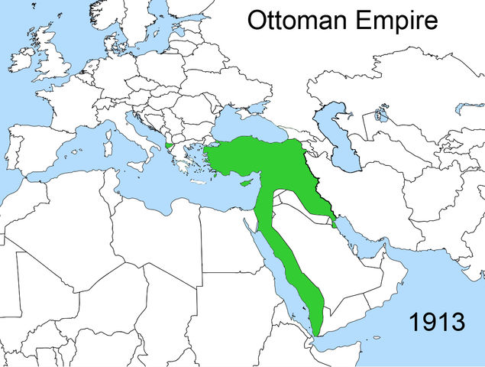

Slide 19
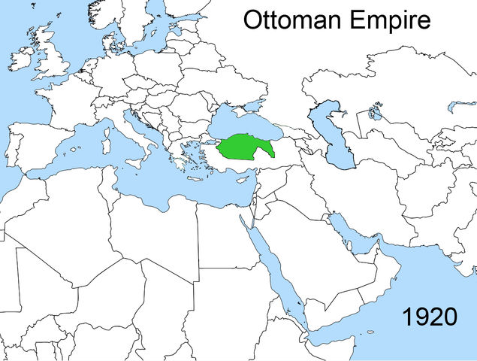

Slide 20
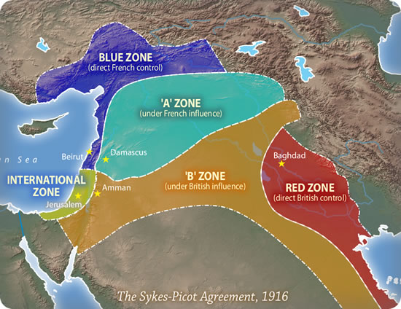

Slide 21
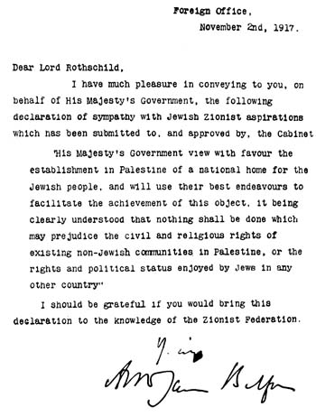
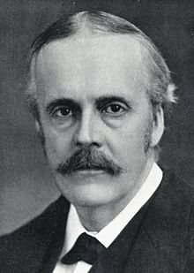
Balfour Declaration

Slide 22
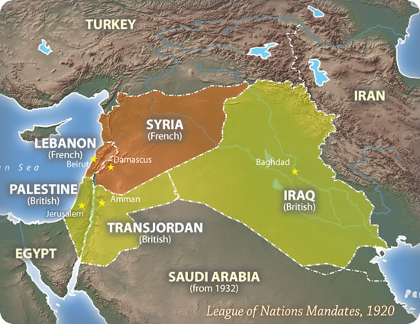

Slide 23
The 1936–1939 Arab revolt in Palestine was a nationalist uprising by Palestinian Arabs in Mandatory Palestine against the British administration of the Palestine Mandate, demanding Arab independence and the end of Jewish immigration as the League of Nations had authorized in 1922.

Slide 24
World War II
DECOLONIZATION

Slide 25
Creation of Israel
Jews had long hoped to establish an independent state in Palestine based on the covenant between Yahweh and Abraham (Genesis 17:7-8)
Arabs rejected this desire with equal passion
After the European anti-Semitism of the 1930s and the Holocaust of World War II, Jews increasingly began migrating to Palestine

Slide 26
Almost 400,000 Jewish refugees fled to Palestine/Israel

Slide 27
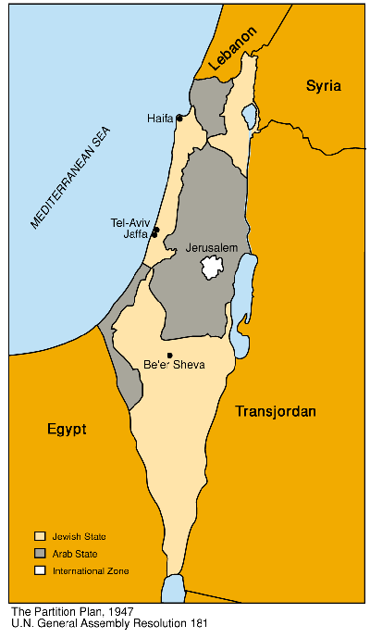
Creation of Israel
Following World War I and the dismantling of the Ottoman Empire, the League of Nations’ mandate gave Great Britain control of Palestine
After World War II, the British concluded they could no longer control the escalating violence between Arabs and Jews and turned the problem over to the United Nations
In November 1947, the UN voted to partition Palestine

Slide 28
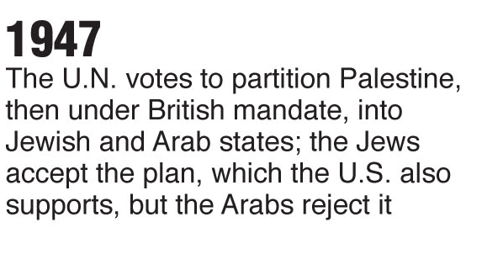
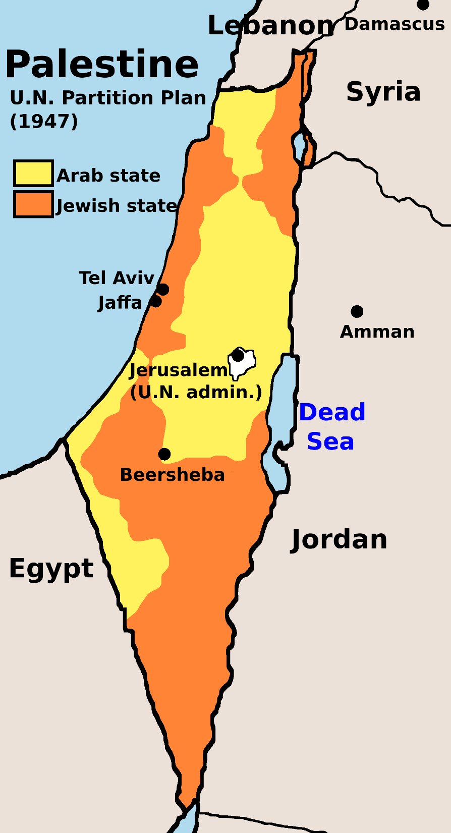
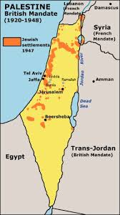

Slide 29
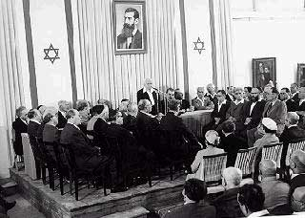
Creation of Israel
British forces withdrew and on May 14, 1948 the Jews proclaimed the establishment of the state of Israel
The next day the Arabs attacked
David Ben-Guiron, first prime minister of Israel, declares Israel’s independence

Slide 30
Civil War breaks out in Israel
DECOLONIZATION
Does this sound familiar?

